Slide 1
LockedMe.com
Developed by : Kanika Gupta

Slide 2
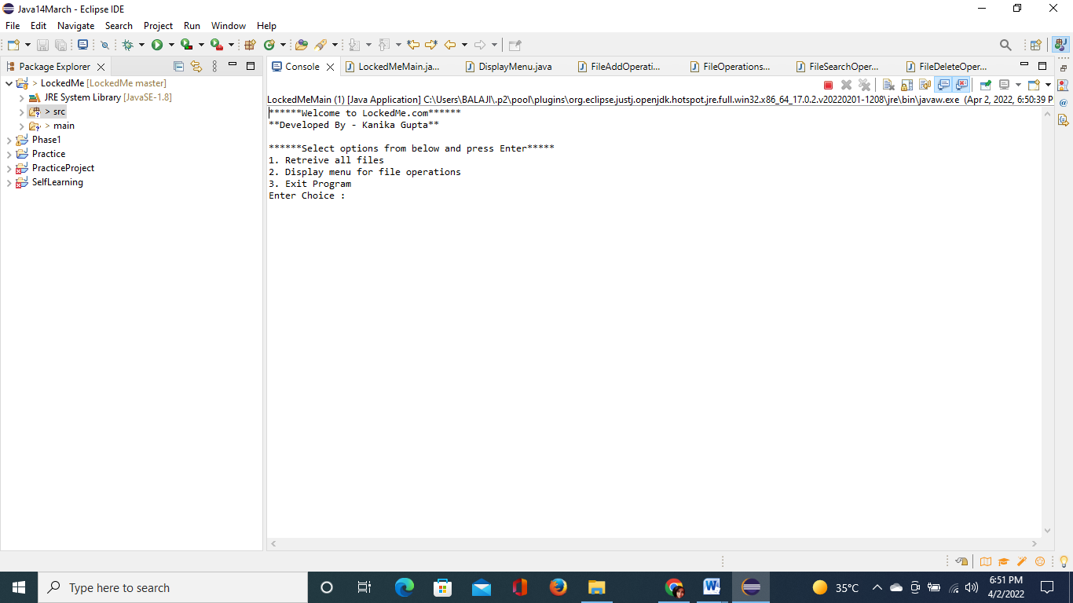
Welcome screen

Slide 3
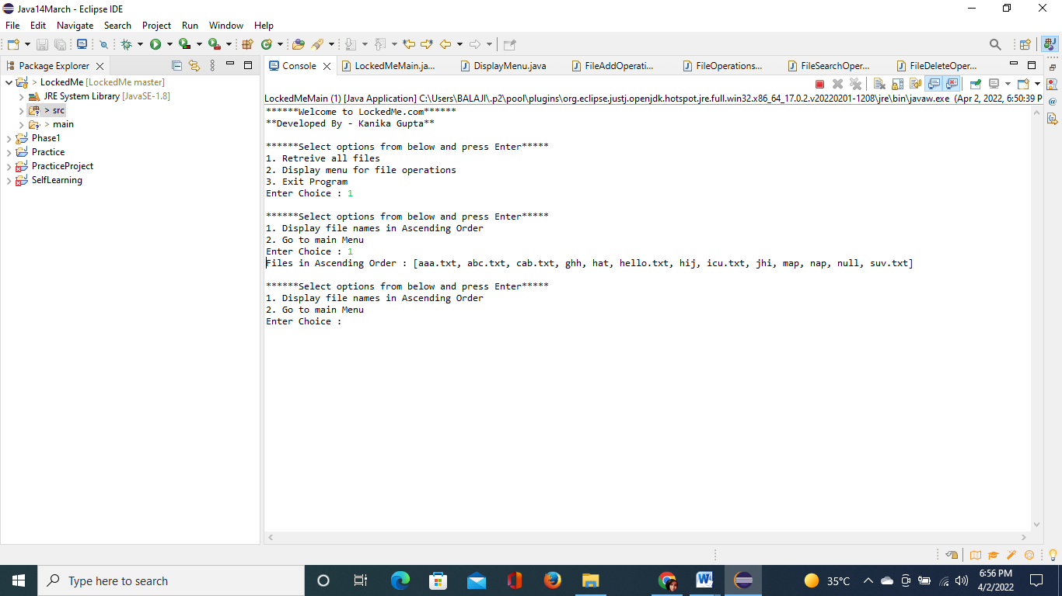
Secondary menu

Slide 4
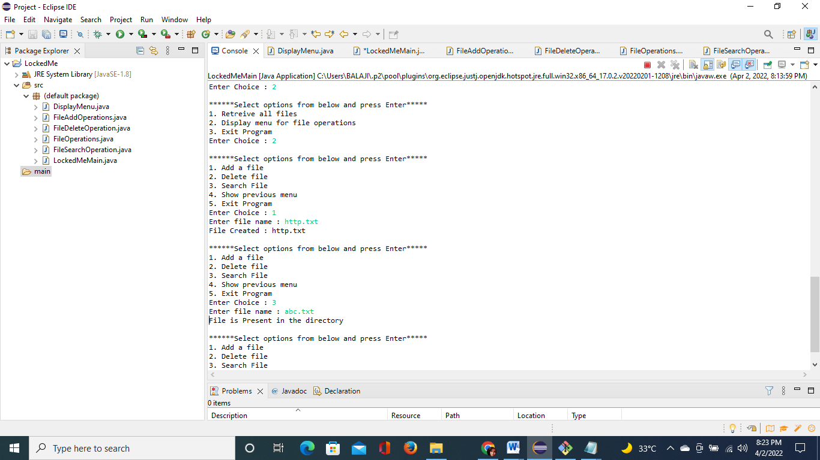
File menu operations

Slide 5
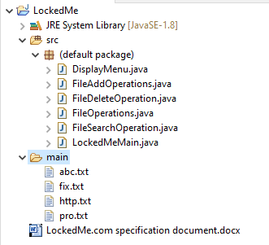
Add file operation

Slide 6
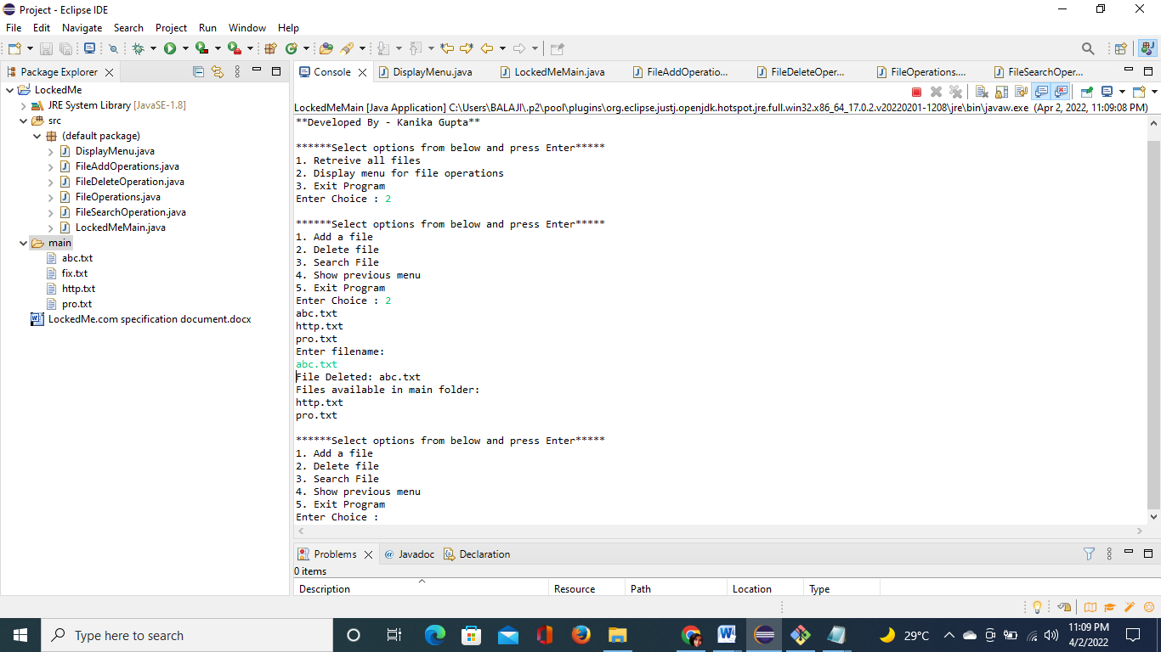
Delete file operation

Slide 7

Search file operation

Slide 8
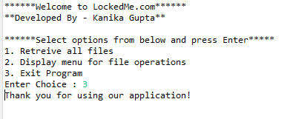
Exit program

